Slide 1

New York City – Taxi Fare
Praga Saha

Slide 2
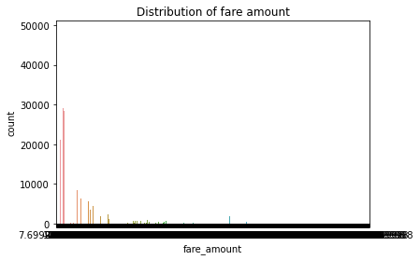
Distribution of Fare Amount
38 fields have negative fare amount values. #Counter({False: 999952, True: 38})
It holds some outlier that is affecting the distribution.

Slide 3
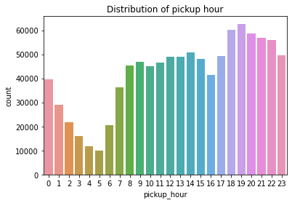
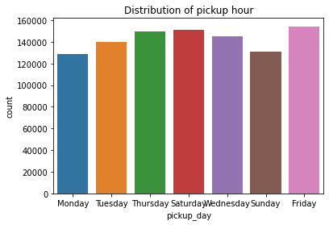
Distribution of Pickup Hour
Pickup hours - 19 to 22 -due to office log out, shifts.
Friday heading the count as its weekend starting and passenger plan for Party/Trips/Travel then follow up by Saturday.
Pickup hours - 19 to 22 -due to office log out, shifts.

Slide 4
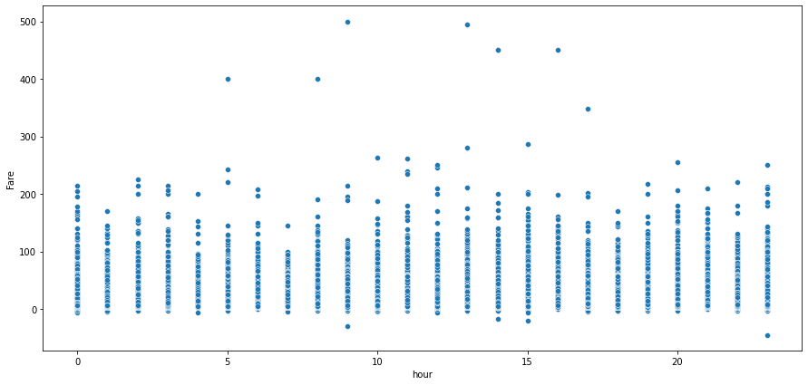
Distribution of Pickup Hour vs Fare

Slide 5
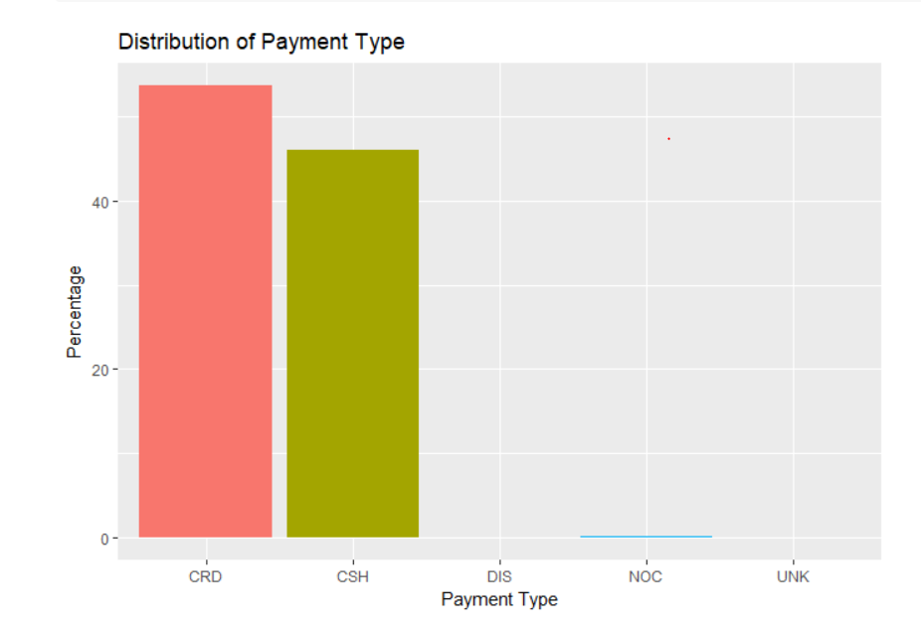
Distribution of Payment Type
Credit Card(CRD) payment is more as compared to Cash(CSH)

Slide 6
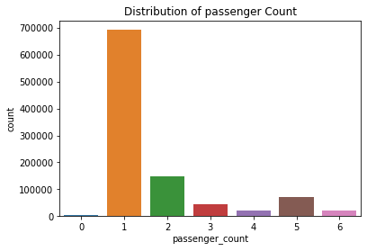
Distribution of Passenger Count
Maximum passenger count =1; people travel solo

Slide 7
Open Questions
1. In what trips can you confidently use respective means as measures of central tendency to estimate fare, time taken, etc. : not sure
2. Can we build a model to predict fare and tip amount given pick up and drop off coordinates, time of day and week?
- based on columns - driver will be aware about the tip and fare
fare_amount ,tip_amount, pickup_datetime, pickup_longitude, pickup_latitude
3. If you were a taxi owner, how would you maximize your earnings in a day?
We will use Random Forest to predict fare amount based on the longitude/latitude, trip duration in secs. (Predicted fare / trip duration)

